Slide 1
Graph

Slide 2
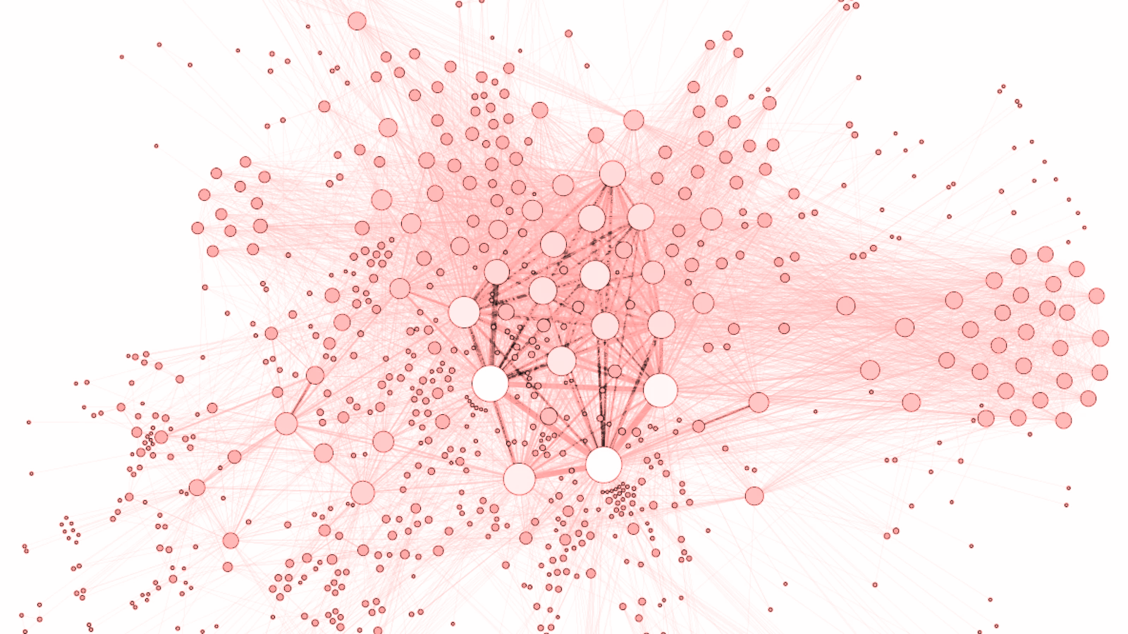
Introduction
Formed by Nodes and Edges.
It can represent
Relationships
Flows

Slide 3
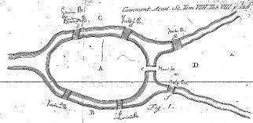
Origin
The Seven Bridges of Königsberg
The problem:
Devise a walk through the city that would cross each of those bridges once and only once.

Slide 4
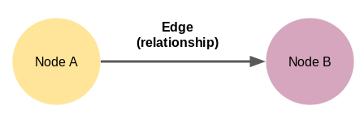
Nodes
Nodes represents entities.
User
Department
Employees
Location
Nodes can carry attributes, e.g. user id, gender, height, DOB, etc..

Slide 5
Edges
Edges can carry attributes.
E.g. number of common interest between two students
Edges can have direction.
E.g. One student like another student

Slide 6
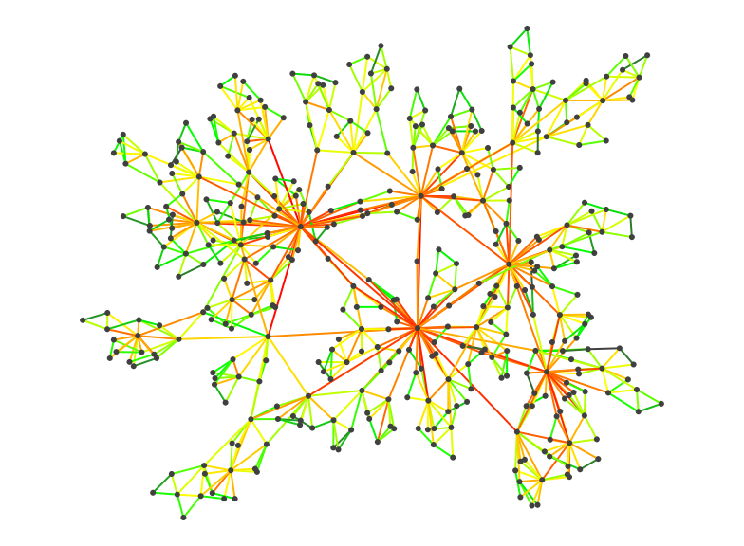
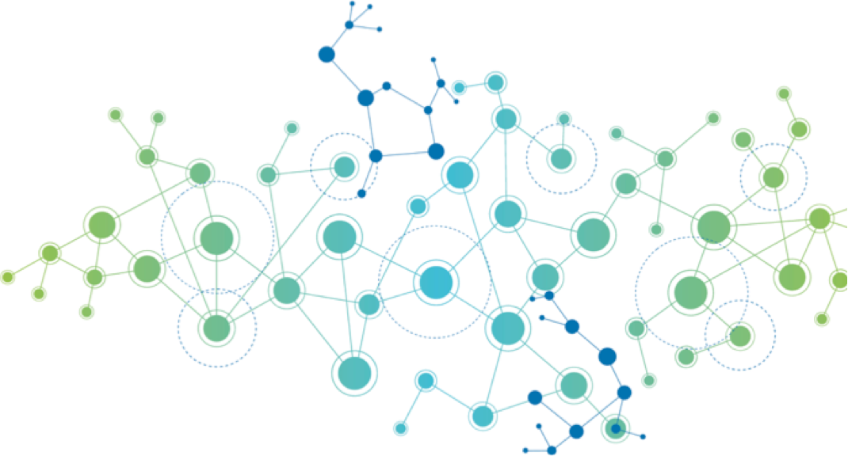
Graphs
Brainstorm:
Where does the color/size come from?

Slide 7
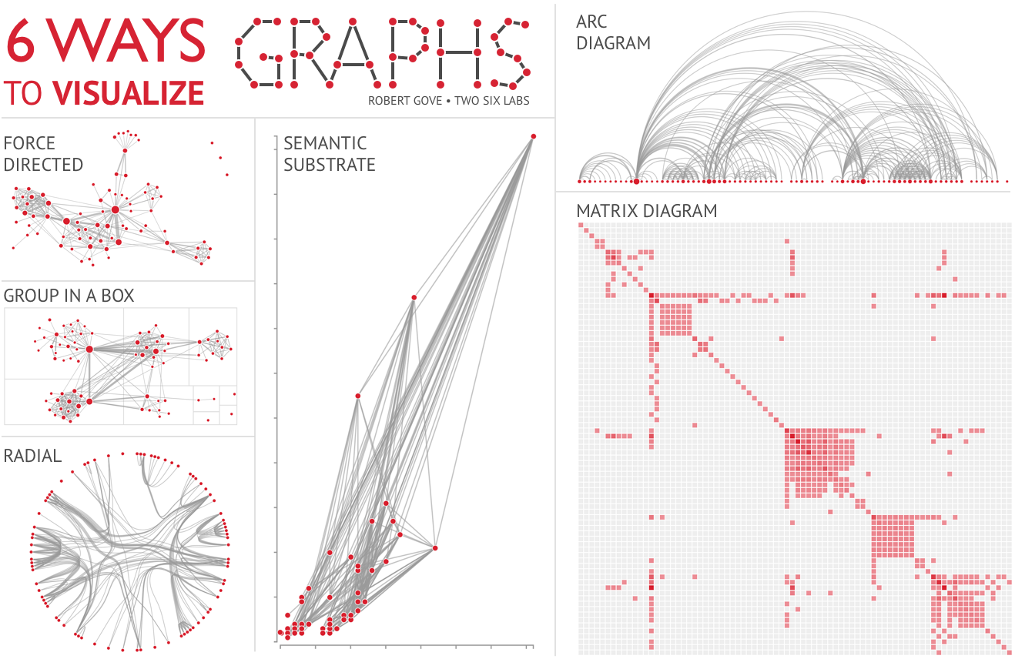
Graph visualization
Visualization is hard.
Small dataset: Easy layout
Medium dataset: Need algorithms
Large dataset: Do not try to layout
https://twosixtech.com/6-ways-visualize-graphs/

Slide 8
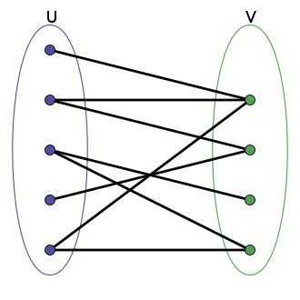
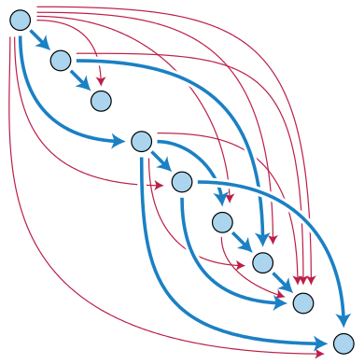
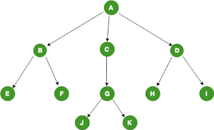
Special types of graphs
Tree
Bipartite graph
Directed acyclic graph (DAG)

Slide 9
Graph measurements
Distance (node – node)
Diameter
Size
Number of connected components
Directed/Non-directed
Cyclic/Acyclic
Density

Slide 10
Node properties
Order (In-order / Out-order in case of directed graph)
Centrality
Eccentricity
Closeness
Betweenness
Eigenvector
PageRank

Slide 11
Edge properties
Centrality
Betweenness

Slide 12
Problems
How to traverse all nodes in a graph?
How to calculate the diameter of a graph?
How to calculate shortest path between two nodes?

Slide 13
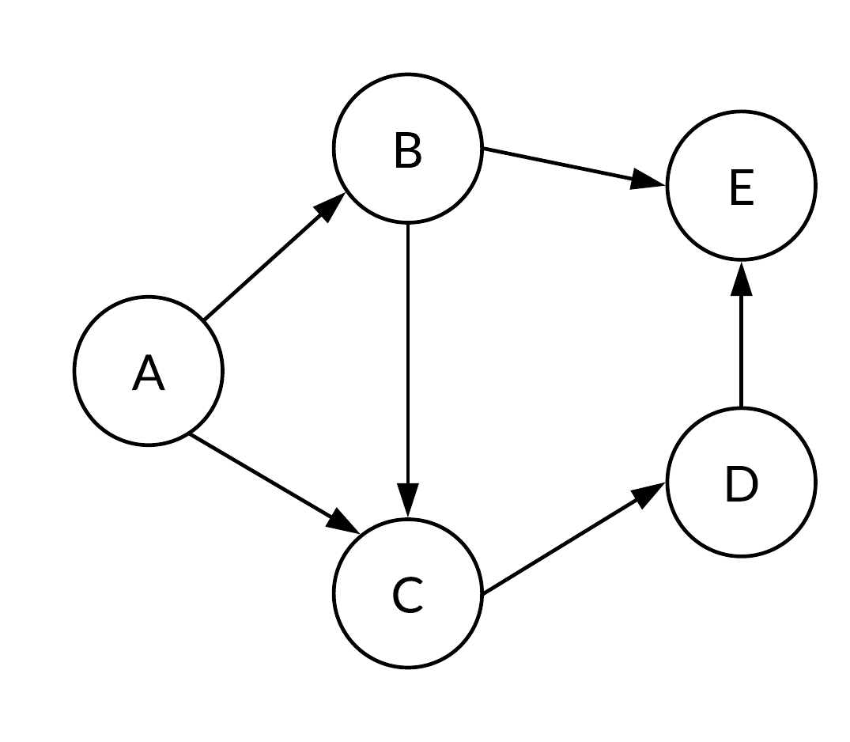
Tabular representation
From | To
A | B
A | C
B | C
B | E
C | D
D | E
From | To
A | B,C
B | C,E
C | D
D | E
E
F\T | A | B | C | D | E
A | 0 | 1 | 1 | 0 | 0
B | 0 | 0 | 1 | 0 | 1
C | 0 | 0 | 0 | 1 | 0
D | 0 | 0 | 0 | 0 | 1
E | 0 | 0 | 0 | 0 | 0
Edge list
Node list
Adjacency matrix

Slide 14
Community detection

Slide 15
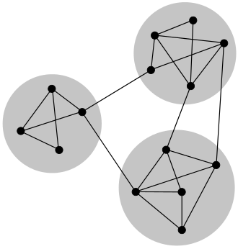
Community detection
Minimum-cut method
Hierarchical clustering
Girvan–Newman algorithm
Modularity maximization
Statistical inference
Clique-based methods

Slide 16
Graph in Python - NetworkX

Slide 17
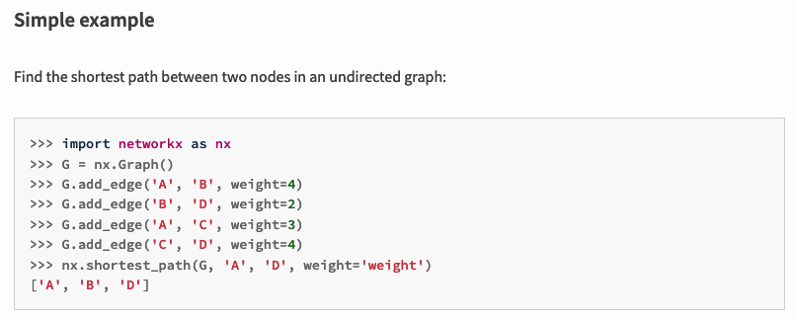
https://pypi.org/project/networkx/

Slide 18
Graph database

Slide 19
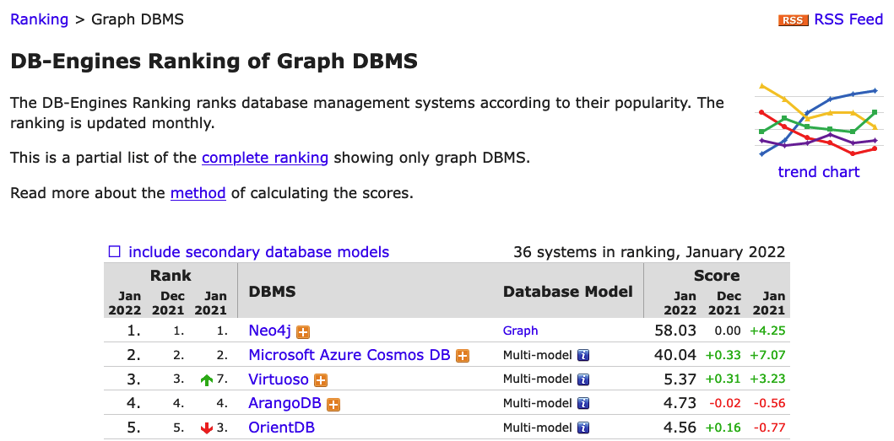
https://db-engines.com/en/ranking/graph+dbms

Slide 20
Advanced usage: Spectral Embedding

Slide 21
Embedding
In machine learning, we often needs to embed something.
E.g.
Word embedding = Vectors for a word
One hot encoding = Vectors for categorical values
A good embedding should carry information.
I.e. Similar vector representations for “dog” and “puppy”.

Slide 22
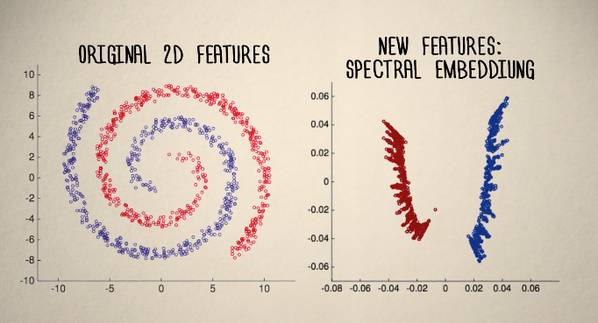
Spectral Embedding
Embedding for non-linearly separable clusters.

Slide 23
Spectral Embedding - steps
For data-points in any dimension:
Connect every points with their K-nearest neighbors
Create an adjacency matrix from the records
Turn the adjacency matrix into a Laplacian matrix
The new embedding is created from the eigenvectors of the Laplacian matrix

Slide 24
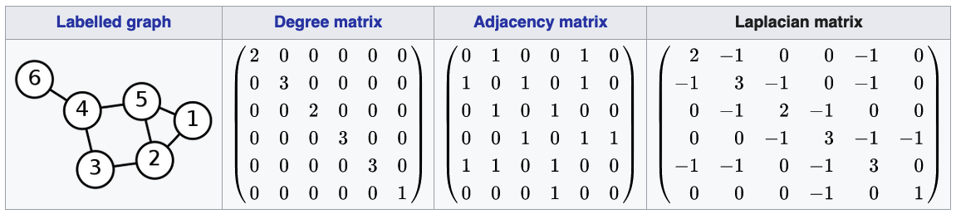
Laplacian matrix
https://en.wikipedia.org/wiki/Laplacian_matrix

Slide 25
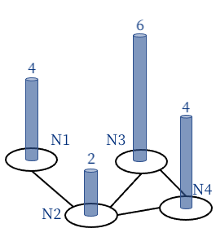
Geometric Interpretation of
Laplacian matrix
Laplacian matrix is used to calculate the “flow”. Imagine each node is a pillar with certain height.
1 | -1 | 0 | 0
-1 | 3 | -1 | -1
0 | -1 | 2 | -1
0 | -1 | -1 | 2
4
2
6
4
Such matrix has very nice properties.
Yet, it’s far beyond our scope to understand all the reasonings behind.
2
-8
6
0
X
=
Laplacian Matrix
Block height
Flow

